Slide 1
Step Into Java:
Edge Detection
Mr. Neat
Java

Slide 2
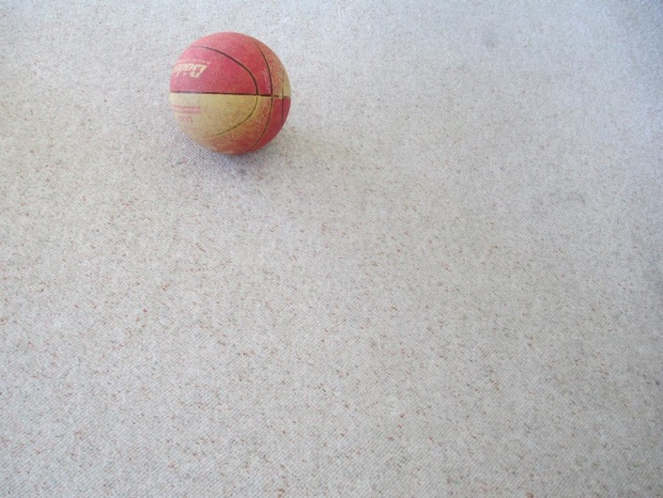

Edge Detection
Our robots usually have a camera
Its goal is to find the game piece…like a ball:

Slide 3
Edge Detection
How?
Compare the Colors of adjacent Pixels
If the difference exceeds a defined threshold,
change the Pixel Color to black, otherwise, white

Slide 4
Edge Detection
How?
Compare the Colors of adjacent Pixels
If the difference exceeds a defined threshold,
change the Pixel Color to black, otherwise, white

Slide 5
Edge Detection
How?
Do you determine the “difference” between 2
Colors?
Answer…the same way you determine the distance
between 2 points…Algebra…

Slide 6
Edge Detection
How?
Distance formula…visually
y
(0,4)
= (3 – 0)² + (0 – 4) ²
x
(3,0)

Slide 7
Edge Detection
How?
Distance formula…for Colors!
green (y)
(0,100,0)
125 = (75 – 0)² + (0 – 100) ² + (0 – 0) ²
red (x)
(75,0,0)

Slide 8


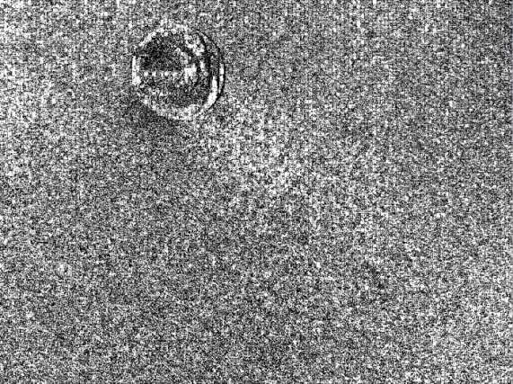
Edge Detection
How?
The Picture class has a method:
  public void edgeDetection(int colorDist)
original
edgeDist = 30
edgeDist = 10

Slide 9
Lab – Color Distance
Write an app that will calculate the distance between
2 colors.
Show the colors and the write the calculated distance
to the screen
Ask the user for the rgb values for the first color (it
should stay the same)
Then each time you click, a new 2nd color should
appear along with the numerical distance between the
2 displayed colors
The example folder has sample output
Put your color distance method in your CVMath class
Method header:
public double colorDist(Color one, Color two)

